Slide 1
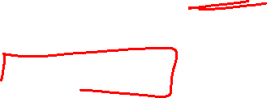
Section 3.3 Derivatives of Trig Functions
Lecture 1
Sine and cosine are all we need

Slide 2

Homework Submission to Canvas
Preview of section
Skim the section in text and write a short paragraph summary.
Give a bulleted list of all important definitions, theorems, and formulas without details.
Notes on video lectures
Take notes on everything written on slides including all details, worked examples, on-own activities, as well as your own thoughts and questions.
Try on-own activities first, then write down provided solution next to it for comparison.
Worked examples from the text
Write down the problem and attempt without looking at the solution.
Use the solution to write the best explanation you can.
Solutions to textbook exercises
Model approaches and explanations given in the video lectures and textbook examples.
Final reflection of section
List the key takeaways to remember as a bulleted list.
Video reflection (for some sections)
Write a 1 paragraph reflection on the video discussing what you found most interesting or useful.

Slide 3
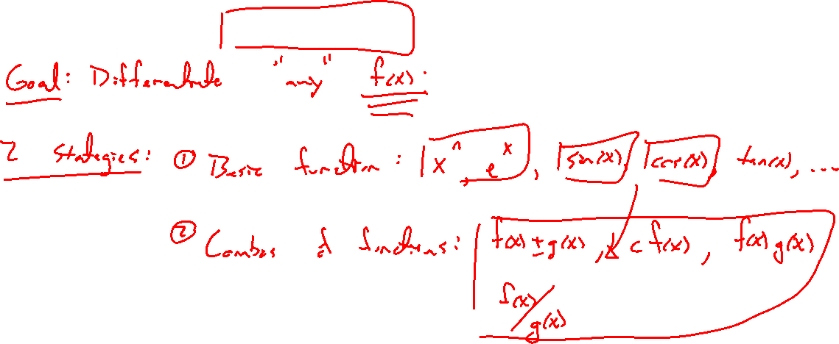
Strategy and theorems
Notes:
Goal is to diff any function f(x) by:
- growing a list of basic functions (trig is next, really sine and cosine are only new ones)
- combining functions in various ways

Slide 4
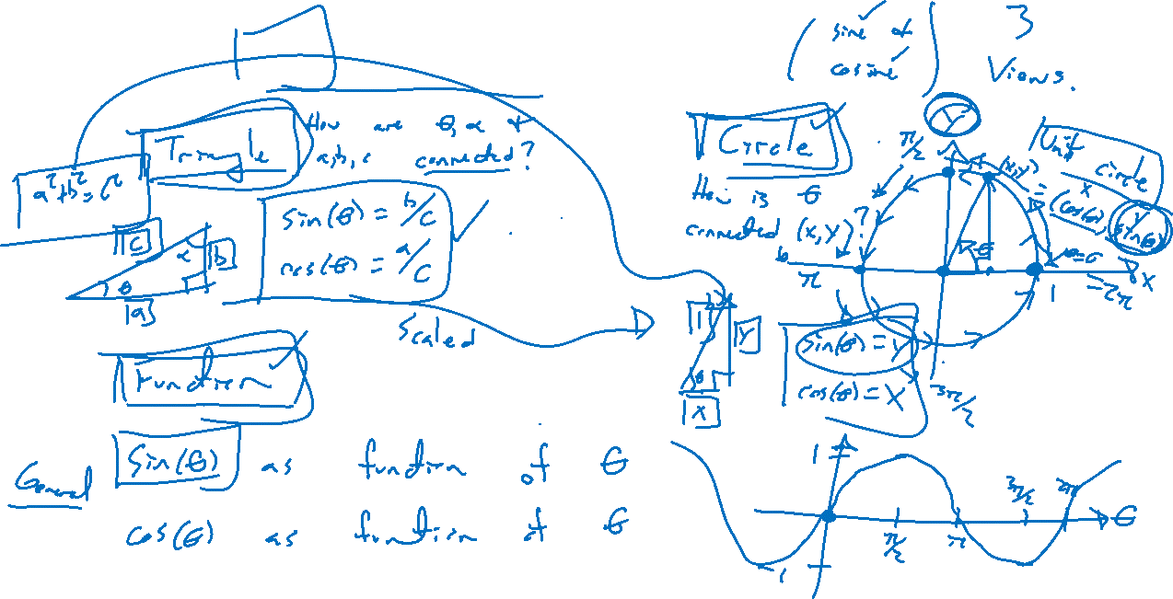
Recall: Trigonometry essentials
Notes:
Sine and cosine only.
Desmos for unit circle / graphs demo.

Slide 5
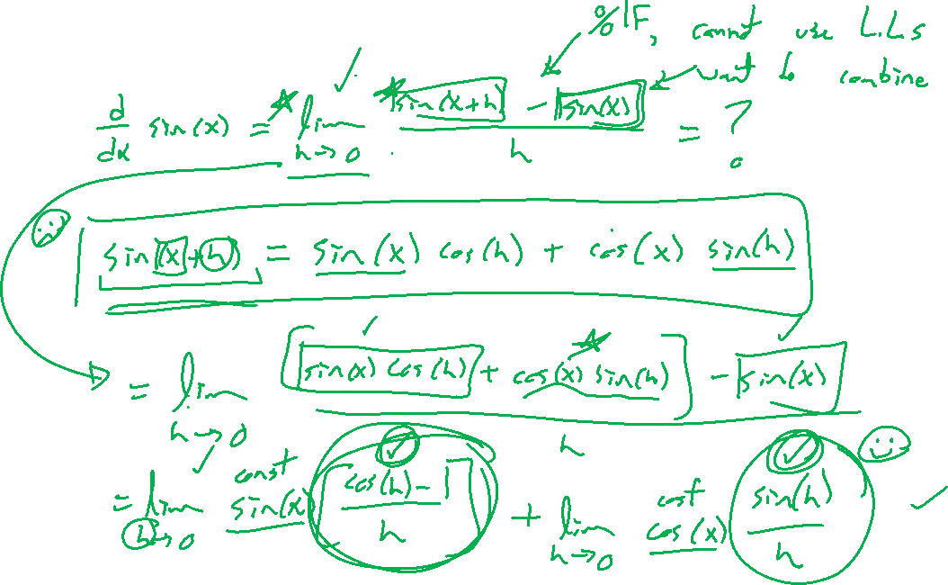
Differentiating sine
Notes:
Difference quotient, need use sum formula for sine.
Sin(u+v) = sin(u)cos(v) + cos(u)sin(v)
2 limits remain: sin(h)/h, (cos(h)-1)/h, both indet form

Slide 6
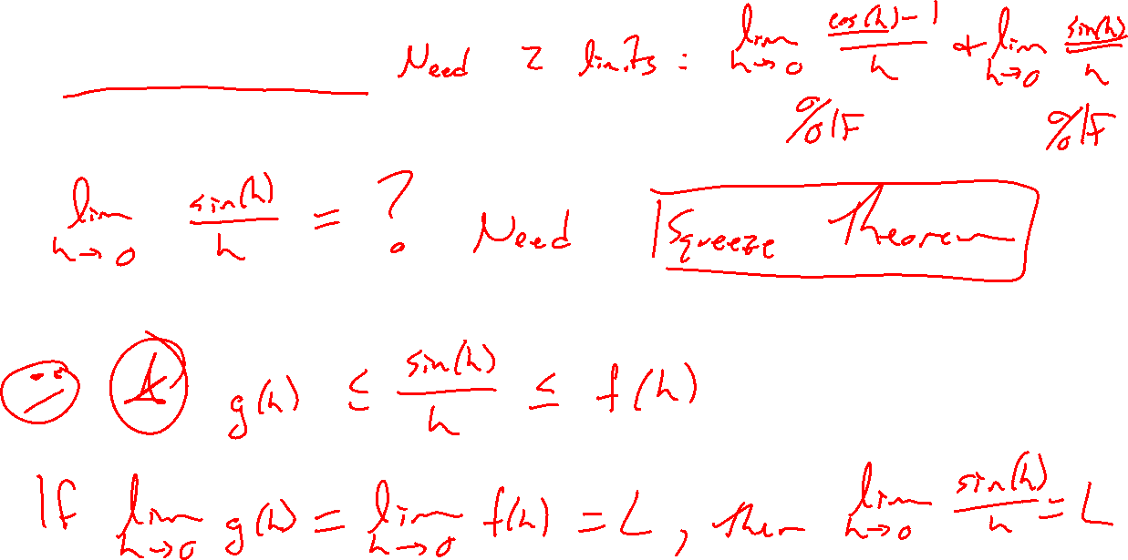
A limit for sine
Notes:
Sin(h)/h, how to compute this limit? Squeeze theorem.
Cos(h) < Sin(h)/h < 1/cos(h)

Slide 7
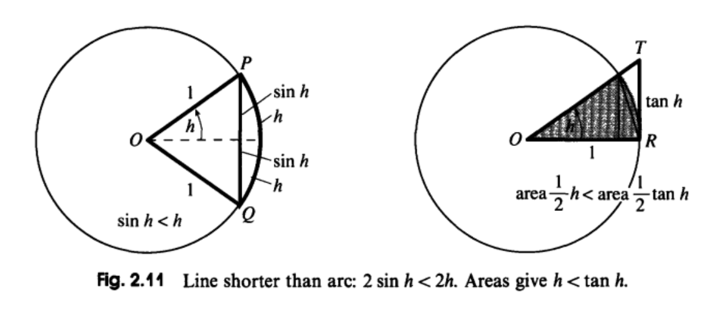
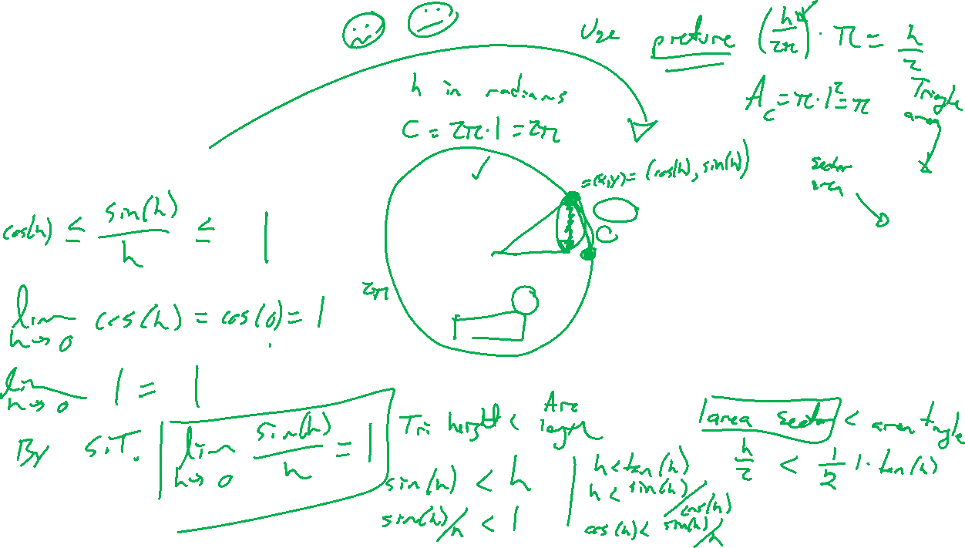
A limit for sine
Notes:
Sin(h)/h, how to compute this limit? Squeeze theorem.
Cos(h) < Sin(h)/h < 1/cos(h)
Use picture to convince. Another picture in text
Note, radians used here is important.

Slide 8
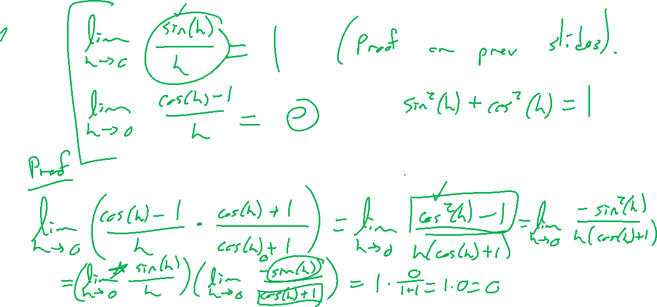
Theorem: Limits for sine and cosine
Notes:
Lim sin(h)/h = 1, lim (cos(h)-1)/h= 0
Prove the cosine one by use of conjugate.

Slide 9
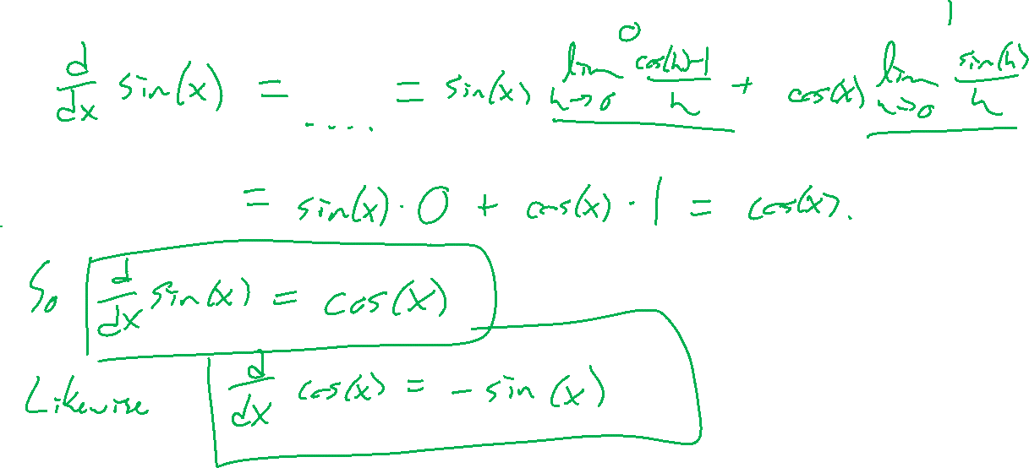
Theorem: Derivatives of sine and cosine
Notes:
Proof, back to earlier work. Cosine in HW.
Desmos.

